Slide 1
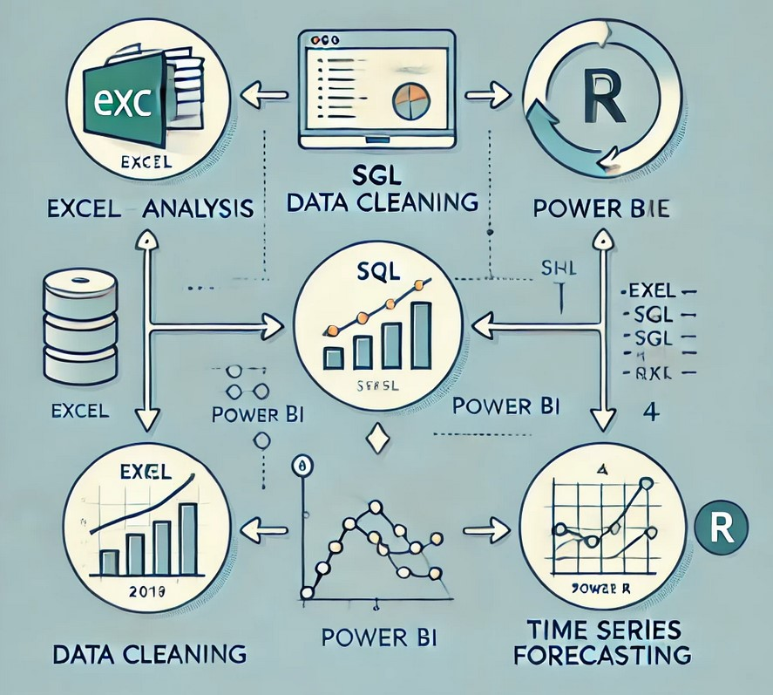
Title: Cancer Incidence in the East of England
Name: Salawudeen Ibrahim Kehinde
Introduction: One in two people will develop cancer in their lifetime, making it critical to analyse regional trends. This presentation examines cancer diagnoses in the East of England, using data from https://www.cancerdata.nhs.uk/covid-19/rcrd (Geography Tab > Downloads > for all Cancer Alliances and cancer sites. Data contain 8 columns (Geography type, Geography, Year, Month, Date, Cancer group, Metric, Statistic) and 134380 rows.
Aim: To investigate regional patterns of cancer incidence in the East of England
Data Analysis Approach for Cancer Incidence in the East of England

Slide 2
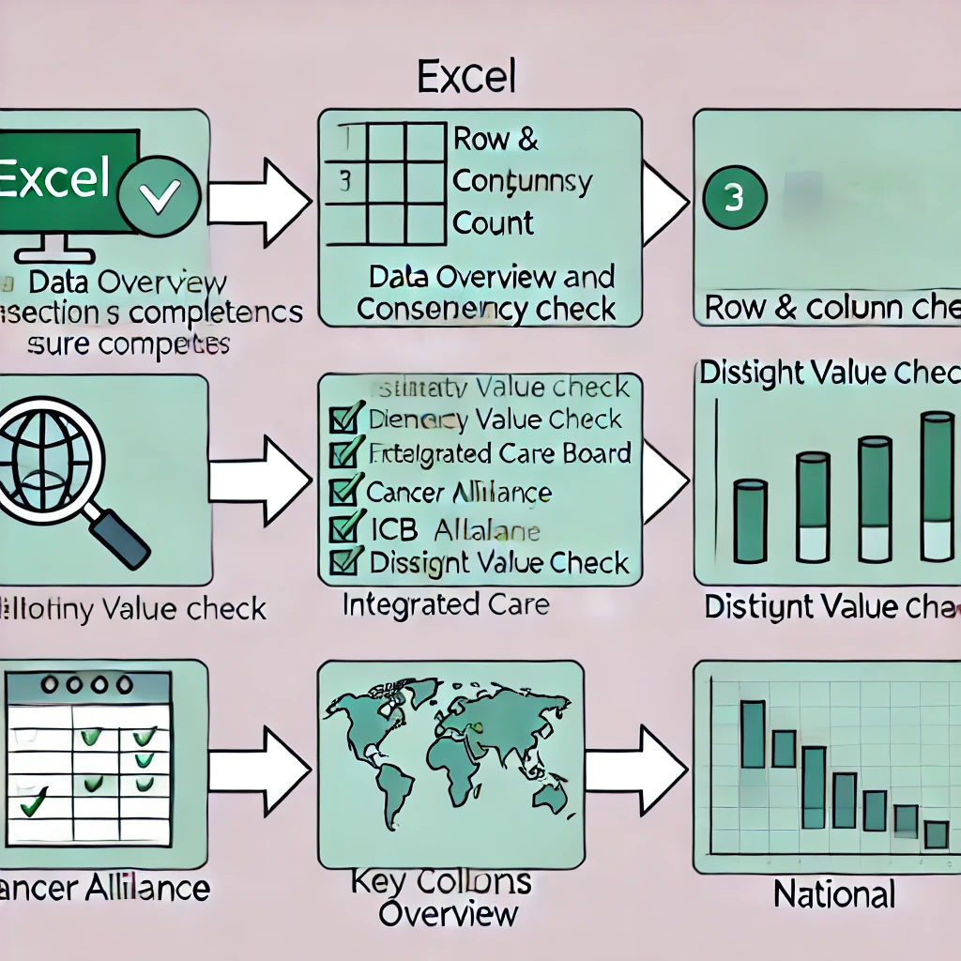
Exploratory analysis with excel
SQL Data cleaning
PowerBI
Remove unnecessary columns ( Year, Month, Metric).
Extract data for "East of England" from the Geography column.
Format the Date column appropriately.
Remove the outlier "All Sites Combined" from the Cancer Group.
Rename columns:
Geography → Region
Statistic → Cancer Diagnoses
Calculate the total diagnoses for each cancer type (Cancer Group).
Display the total number of cancer cases overall.
Maximum and Minimum Diagnoses:
Identify and visualize the highest and lowest diagnoses recorded for any type.
Percentage by Cancer Type:
Calculate and display the proportion of total diagnoses attributed to each cancer type.
Regional Diagnoses Rate:
Show the frequency or rate of diagnoses for each cancer type within specific regions.
Trends Over Time:
Visualize how cancer diagnoses have changed over the time series (2018–2024).
Moving Average:
Compute and plot a moving average to smooth fluctuations in diagnoses over time.
Comparison of Cancer Groups:
Compare diagnoses across different cancer types and regions to highlight variations.
Interactive Dashboard:
Build an interactive dashboard for stakeholders to explore data trends and make informed decisions.
Data quality check
Row Count:Ensure the dataset does not exceed 134,380 rows.
Column Count: Verify there are exactly 5 columns:
Confirm appropriate data types for each column:
Geography Type: varchar
Region: varchar
Date: date format
Cancer Group: varchar
Cancer Diagnoses: numerical/integer
Duplicate Check:
Ensure there are no duplicate records in the dataset.
Null or Empty Value Check:
Verify there are no missing or empty values in critical columns.
Outlier Check:
Confirm there are no more than 10 outliers per Cancer Group.
Time Series Decomposition: Break down the data into components to examine long-term trends, seasonal patterns, and irregular variations.
Forecasting Model: Utilize ARIMA (AutoRegressive Integrated Moving Average) to predict future cancer diagnosis rates in the East of England.
Insight Generation: Offer actionable insights based on trends and forecasts, enabling stakeholders to anticipate and address future cancer diagnosis patterns effectively.

Slide 3
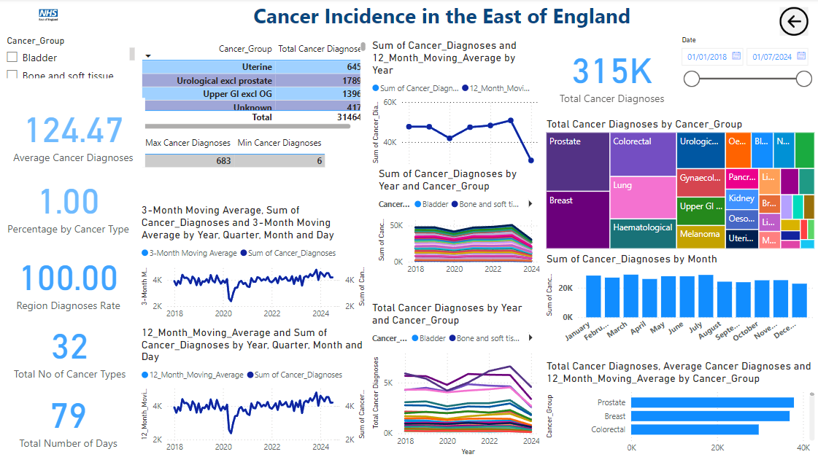
Insights by Cancer Group:
Variation Across Cancer Types:
Prostrate cancer consistently shows the highest diagnosis rates annually, follow by breast cancer. Bone and soft tissue cancers display smaller numbers but a steady upward trend.
Total Diagnoses Over Time:
While total diagnoses fluctuate, a slight overall increase is noted up to 2022, followed by stabilization or a small decline.
Insights:
Recovery trends suggest improvements in healthcare post-pandemic.
Shifts in specific cancer group diagnoses may indicate changing diagnostic practices or healthcare focus.
Powerbi -link
https://boltonuni-my.sharepoint.com/:u:/g/personal/is4crt_bolton_ac_uk/EbMx5nqY_MBChf7Sm8YrHj4BdqVwlHBBm0r3YbqXfbUpwA?email=ibrahimsalawudeen03%40gmail.com&e=5URkCI
Key Trends in Cancer Diagnoses:
Seasonal Variability:
The 3-month moving average highlights seasonal fluctuations, with certain months showing higher diagnoses.
Impact of COVID-19 (2020):
Both 3-month and 12-month moving averages reveal a decline in diagnoses in 2020, likely due to disruptions in healthcare services caused by the pandemic.
Recovery Post-2020:
Diagnosis rates show a recovery trend after 2020, with a stable or slightly increasing long-term pattern, reflecting resumed healthcare activities.
Yearly Diagnosis Trends:
A fluctuating pattern is observed in the yearly sum of diagnoses, with a significant drop post-2021, which requires further investigation to understand potential causes. November 2023 has the highest number of diagnoses of prostate cancer while May 2020 shows the lowest

Slide 4
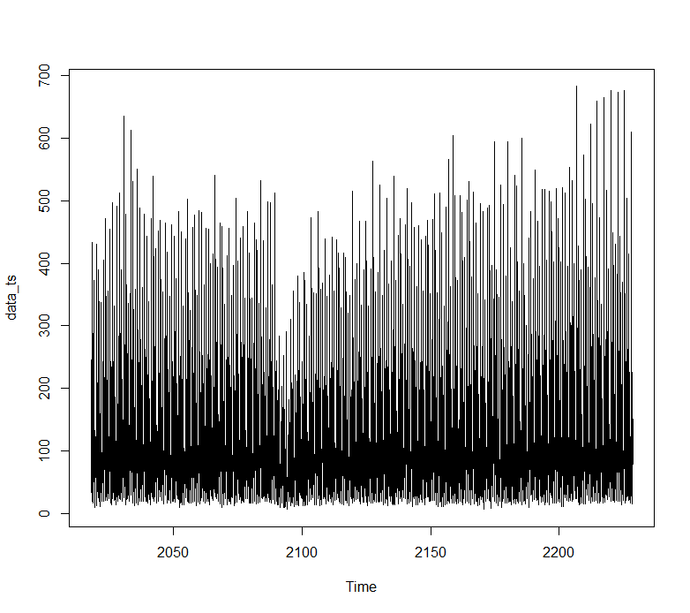
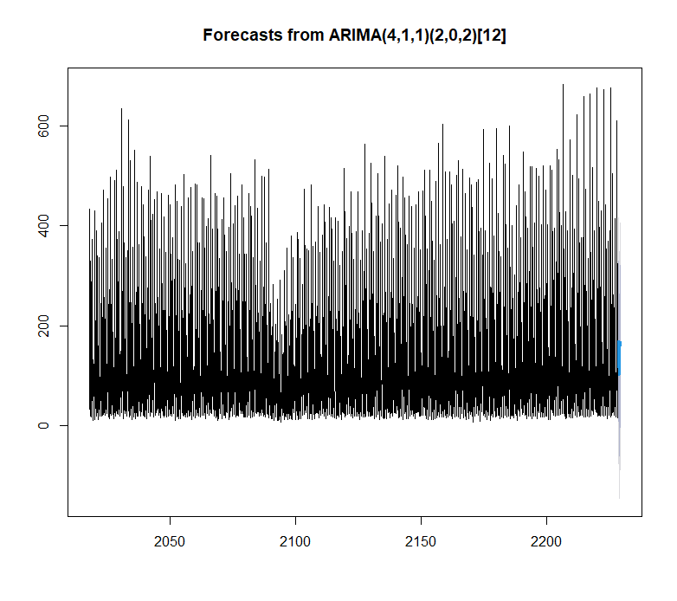
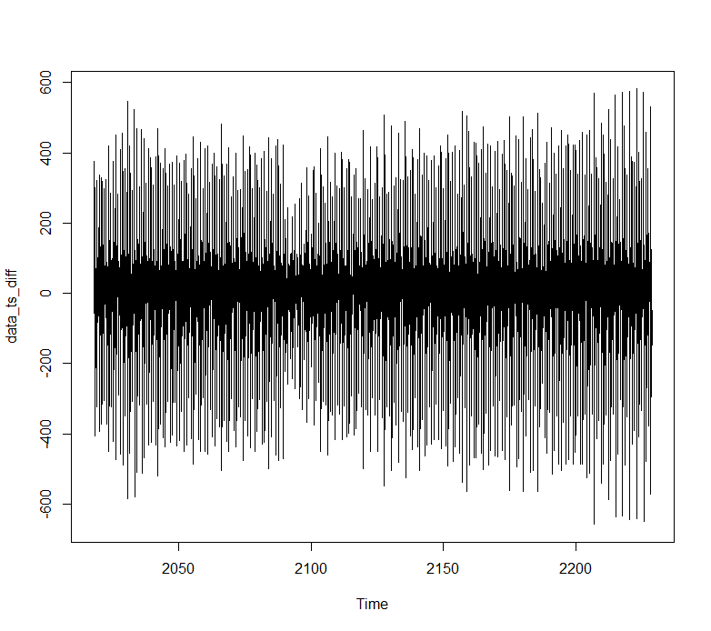
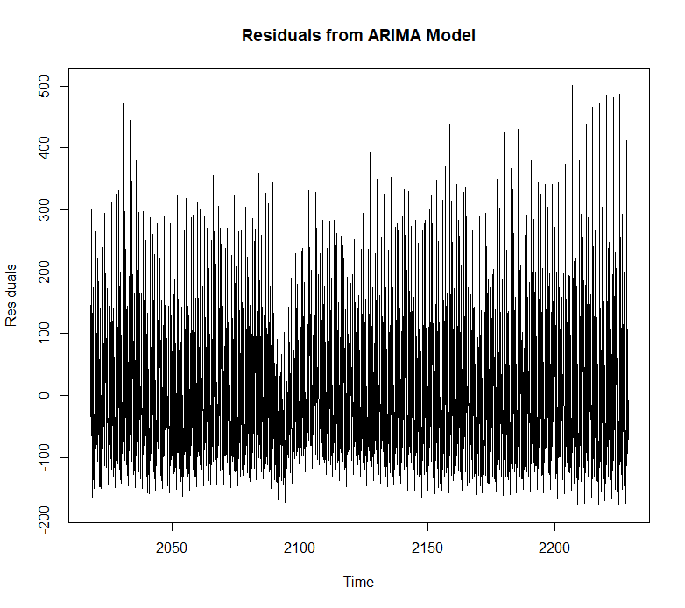
Plot the time series to visualize trends and seasonality
> summary(model)
Series: data_ts
ARIMA(4,1,1)(2,0,2)[12]
Coefficients:
ar1 ar2 ar3 ar4 ma1 sar1 sar2 sma1 sma2
-0.2956 -0.0505 -0.1187 -0.1404 -0.9886 0.0876 0.0586 -0.2168 -0.2360
s.e. 0.0201 0.0211 0.0247 0.0515 0.0032 0.3632 0.1530 0.3626 0.2001
sigma^2 = 14611: log likelihood = -15700.96
AIC=31421.91 AICc=31422 BIC=31480.26
Training set error measures:
ME RMSE MAE MPE MAPE MASE ACF1
Training set 1.120409 120.6369 94.03525 -120.1777 162.522 0.6851107 0.008158782
This ARIMA model fits the data with some areas of improvement, as indicated by higher error metrics like MAPE.
The forecast suggests that the values in the future will likely follow a similar pattern to the historical data, but the variability in the forecast increases with time, especially in the distant future (shown by the wider confidence intervals). The model has captured the seasonality well, as reflected in the oscillations of the forecast aligned with the seasonal patterns in the data. The high volatility (spikes) in the forecast toward the end of the series may indicate unusual events or outliers that the model has trouble predicting precisely.
Differencing since necessary to make the series stationary
p-value from the Augmented Dickey-Fuller (ADF) test is 0.01. Since your p-value (0.01) is less than 0.05 (the common significance level), reject the null hypothesis. This means that there is strong evidence to suggest that the time series is stationary. A p-value of 0.01 indicates that the time series is likely stationary and does not have a unit root. This is a good result, as stationarity is typically a necessary assumption for models like ARIMA.
Clear seasonality in the historical data.
Forecasts (Blue Line):
Predicted future values align with seasonal trends from the historical data.
Confidence Interval (Gray Area):
Uncertainty increases as the forecast horizon extends.
Wider intervals in distant future indicate less confidence.
Model Observations:
Captures seasonality effectively.
High volatility (spikes) toward the end suggests possible outliers or events the model struggles to predict accurately.
Key Takeaways
The model predicts future trends well, with seasonality captured.
Confidence decreases further into the future, reflecting inherent uncertainty.
Spikes in variability may highlight areas for further investigation or model refinement.

Slide 5
Conclusion and Recommendations
The residuals appear to fluctuate around a mean of approximately zero, which is desirable in a well-fitted ARIMA model. This suggests that the model is unbiased on average.
However, there seems to be considerable variability in the residuals, with some periods having higher spikes than others.
Variance Consistency:
The residuals show relatively consistent variance throughout the time series, which indicates that the assumption of homoscedasticity (constant variance) may hold. Any noticeable increase or clustering in variance over time would suggest issues in the model.
Extreme Values: There are some noticeable extreme spikes, both positive and negative, which could represent outliers in the data or periods where the model underperformed.
Yearly Fluctuations: Overall, there’s a visible fluctuation in the data, which could be impacted by multiple factors like changes in diagnostic practices, public health policies, or even improvements in early detection techniques.
Cancer Type-Specific Analysis: Different cancer types have different diagnostic patterns. Identifying which cancer types are more prevalent could help guide public health initiatives or resource allocation. hiring more staff during peak times or increasing diagnostic capacity.
Analyze the drop in 2020 to ensure contingency plans for similar disruptions in the future. Monitoring and Evaluation: Use the 12-month average to evaluate the long-term effectiveness of public health campaigns or diagnostic initiatives.
Public Awareness Campaigns: Focus campaigns during months of low diagnoses (as seen in the 3-month average) to address potential gaps in awareness or service access.
The behavior of each cancer type may suggest that diagnostic patterns or healthcare responses differ across cancer groups. It would be useful to explore why certain cancers are increasing more rapidly than others or why some are declining.
Potential Decline: The decline in diagnoses seen in the first graph should be further explored. It might indicate a broader trend related to the healthcare system or environmental factors.

